Slide 1
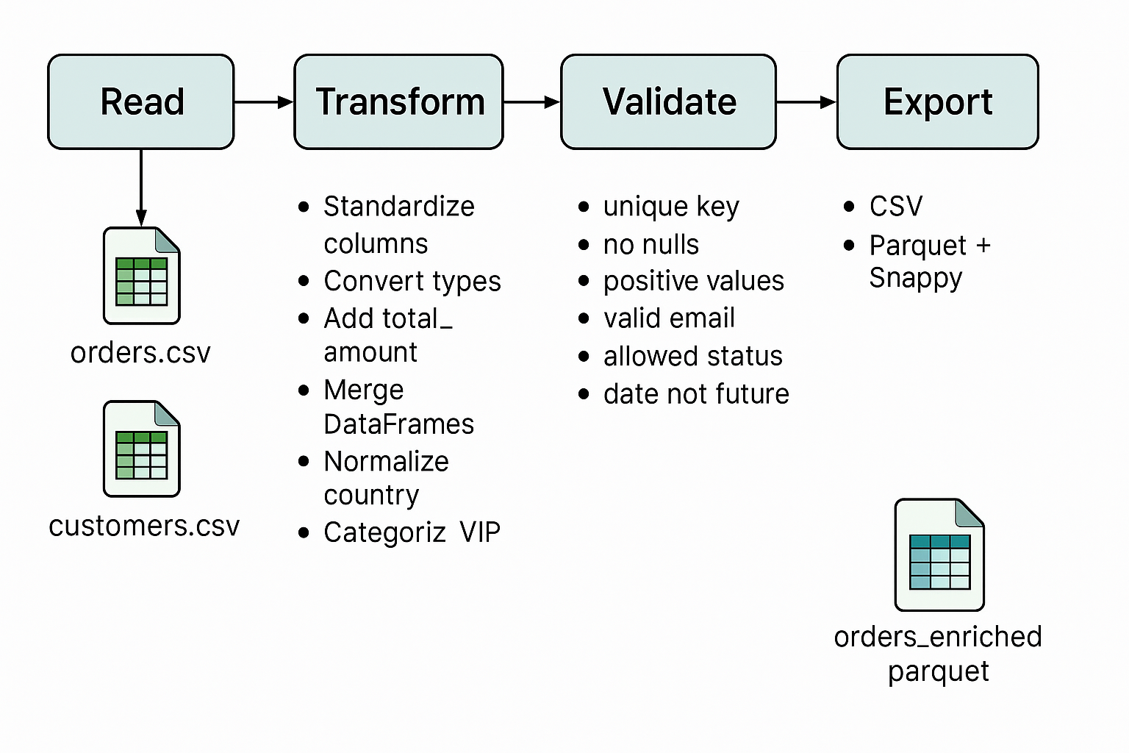
Data Flow Pipeline

Slide 2

Folders Structure

Slide 3
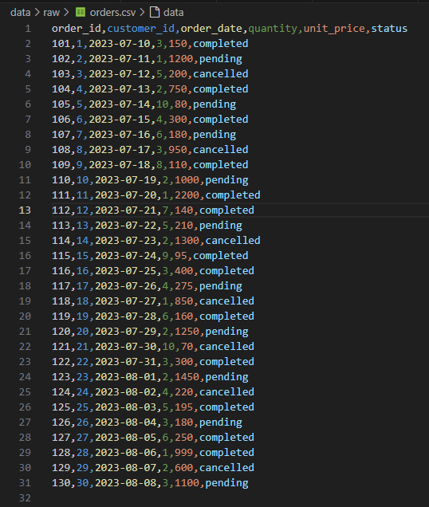
Data Raw (orders.csv)

Slide 4
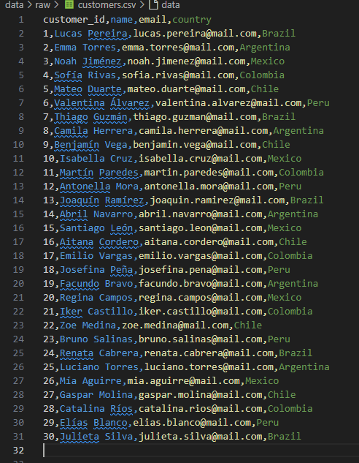
Data Raw (customers.csv)

Slide 5
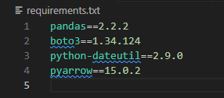
requirements.txt

Slide 6
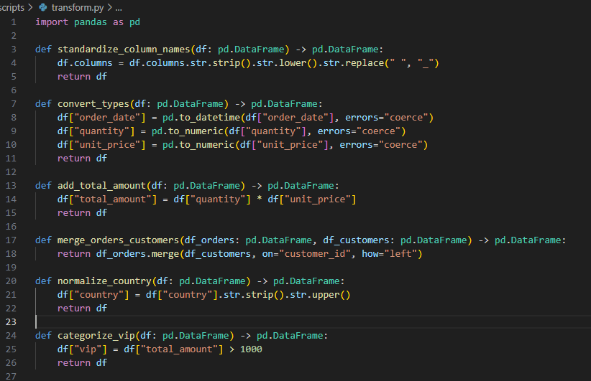
transform.py

Slide 7
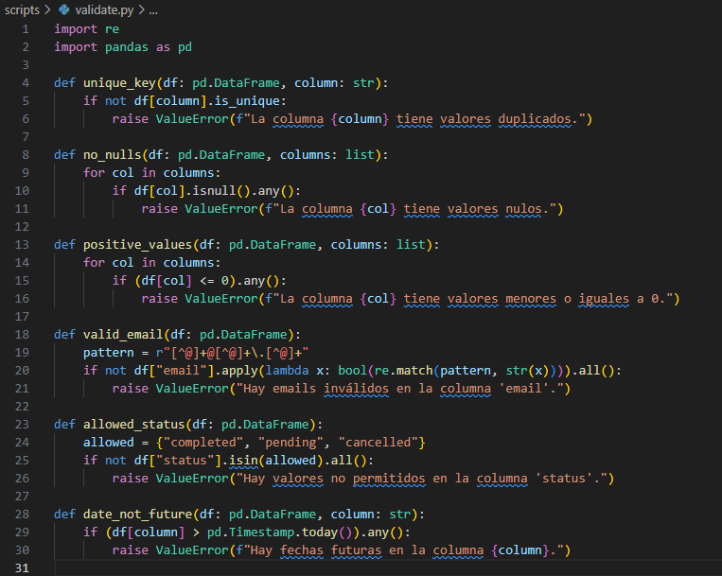
validate.py

Slide 8
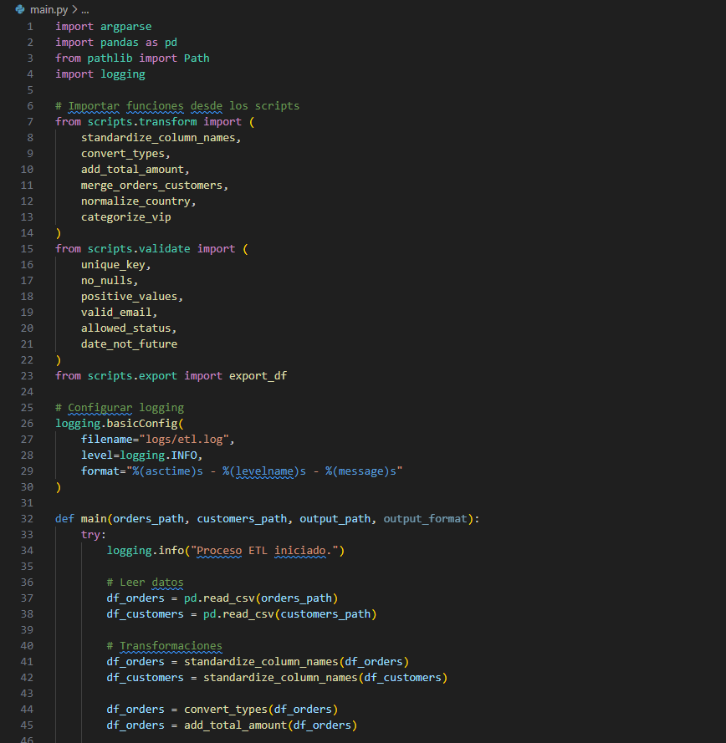
main.py (parte 1)

Slide 9
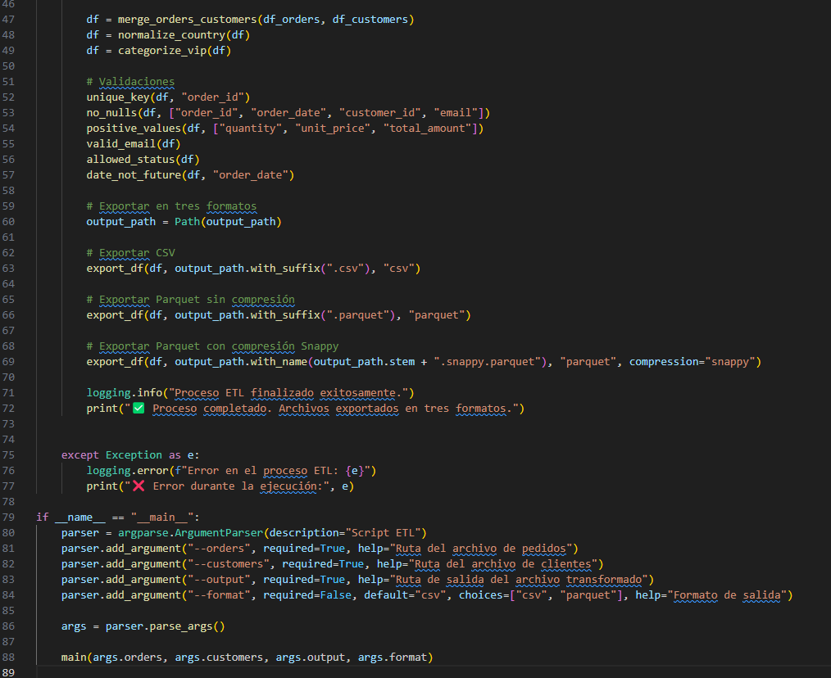
main.py (parte 2)

Slide 10
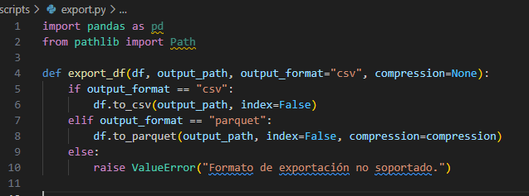
export.py

Slide 11
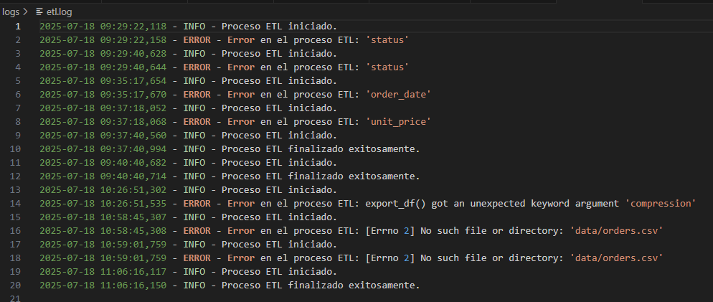
etl.log

Slide 12
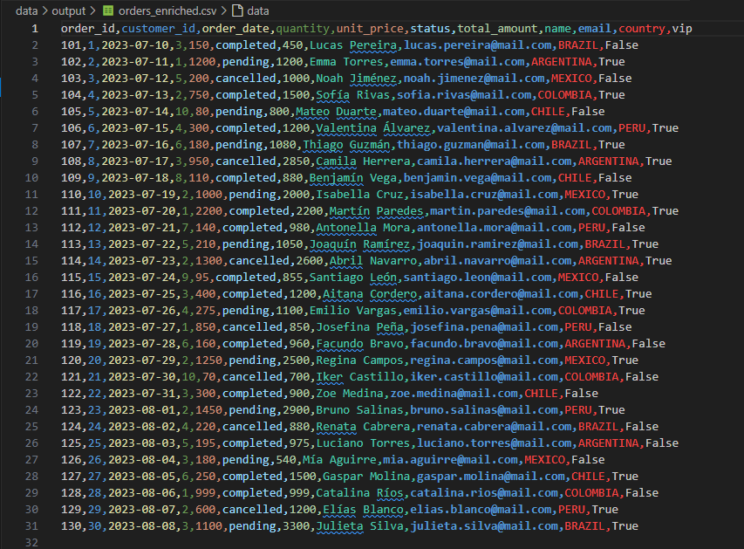
Data Output (.csv)

Slide 13
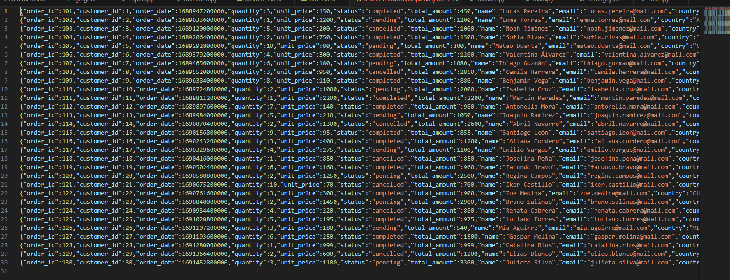
Data Output (.parquet)

Slide 14
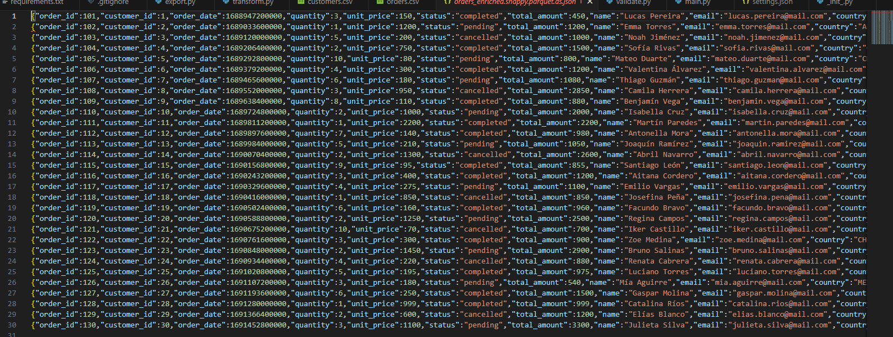
Data Output (.snappy)

